Slide 1
ChadaTech Scrum Development
A Sprint Review and Retrospective
of the
SNHU Travel Web App Project

Slide 2
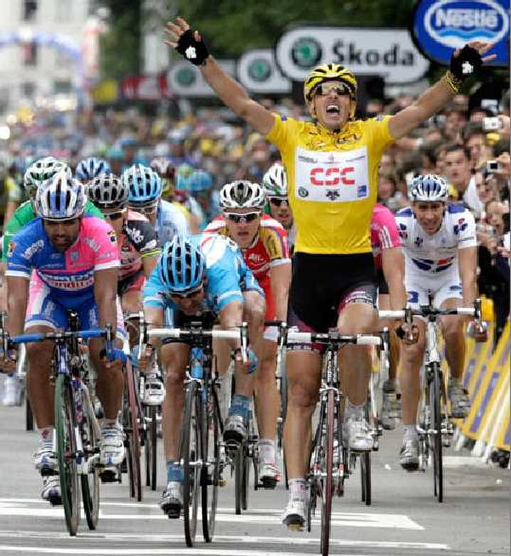
Agile Development
“…succeeding in an uncertain and turbulent environment” (Agile Alliance, 2018)
Developing software by realizing and adapting to change
Utilizing teams based on empirical processes, collaboration, and cross-functional skills
Photo: (Ena, 2007), Creative Commons

Slide 3
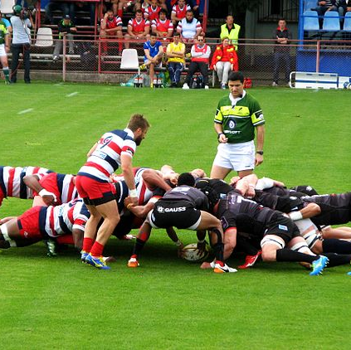
Scrum
An agile framework based on:
People and collaboration
Honesty and openness
Empowerment
Small teams producing working products each Sprint
(Rubin, 2012)
Photo: (Gabinho, 2017), Creative Commons

Slide 4
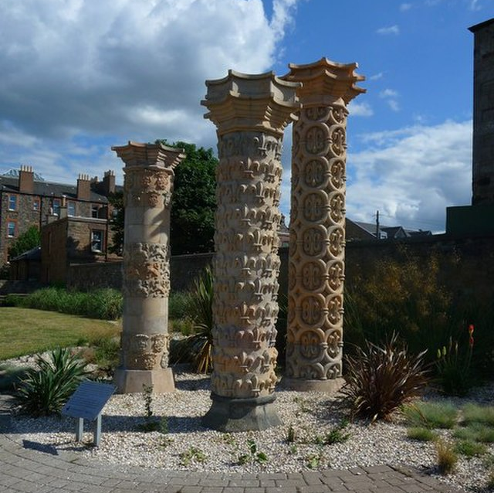
Scrum (cont.)
Supported by three pillars
Transparency
Work, decision making, and processes are “visible” and open to everybody
Inspection
Products and process are frequently inspected for quality and improvement
Adaptation
Adjusting to priorities and change in requirements, and continually improving
Photo: (Leask, 2010), Creative Commons

Slide 5


Roles
Client
Defines how end-product should meet business needs and goals
Customers
Involved throughout feedback loop
Photos: SNHU Travel Case Study

Slide 6


Roles (cont.)
Product Owner
Central point of contact with overall vision of project, and determines priorities and quality standards
Scrum Master
Servant leader who coaches the team through scrum process, removing blockers, and enabling self-organization
Photos: SNHU Travel Case Study

Slide 7


Roles (cont.)
Developer(s)
Determine “how” to produce high quality product, turning customer needs to working software
Tester(s)
Integrated with “whole-team” providing continuous testing, automated testing, and acceptance testing
Photos: SNHU Travel Case Study

Slide 8
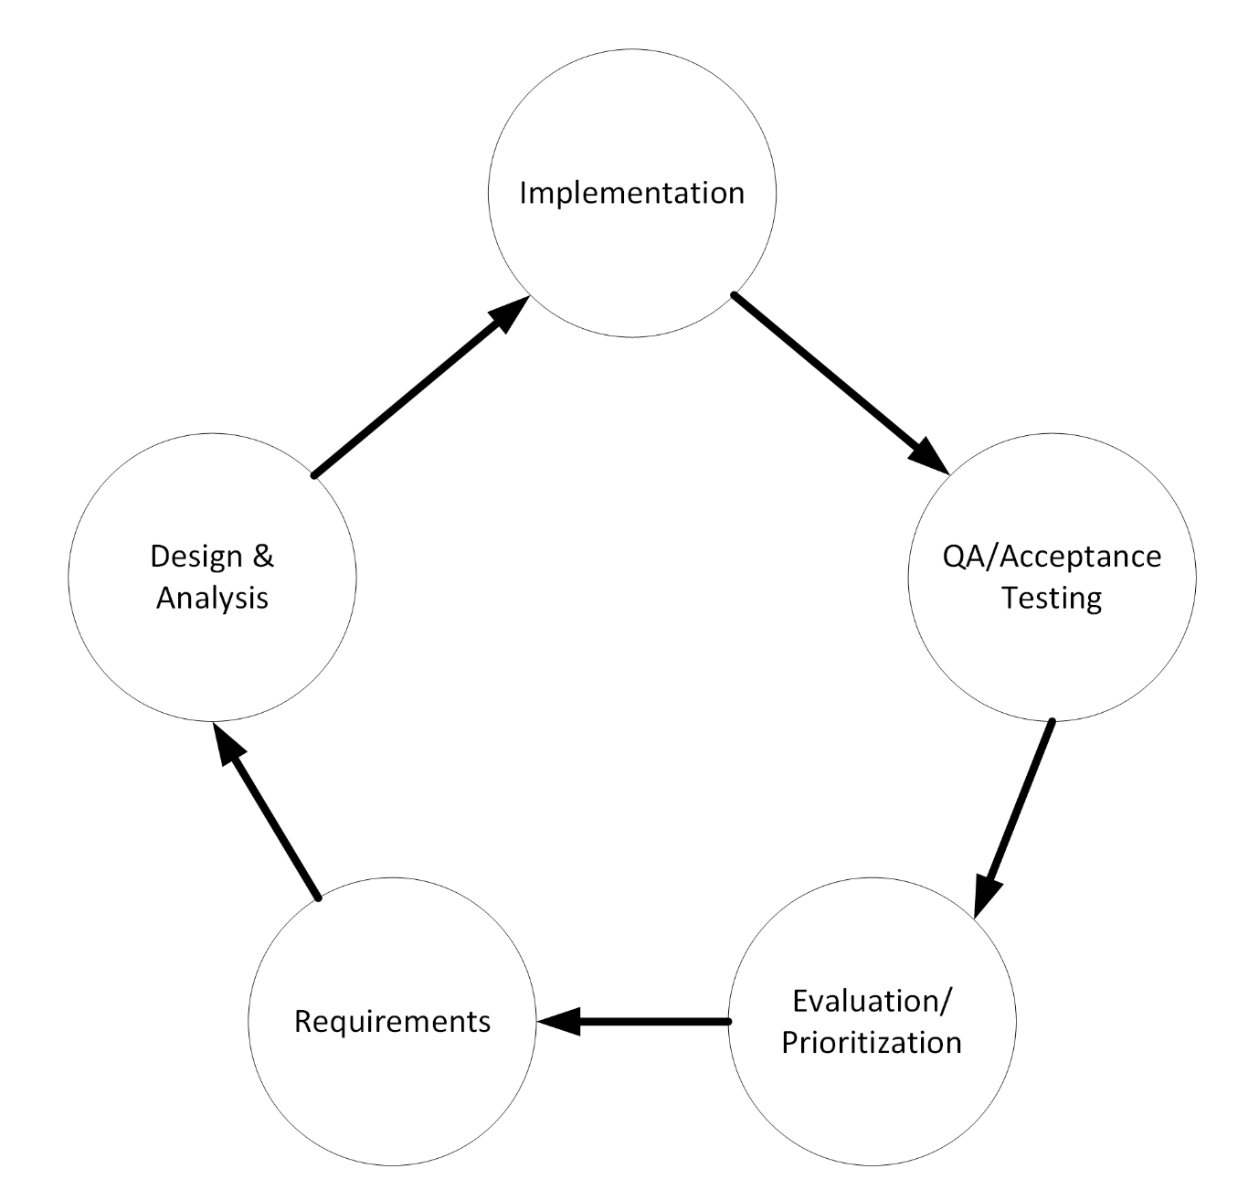
Agile Phases
Iterative methodology
Working product is delivered at the end of each iteration/sprint
“Adaptative” to changing requirements and business priorities
Phases are accomplished in five events, and three artifacts
Diagram: (Ingeno, 2018)

Slide 9
Agile Phases (cont.)
Requirements are loosely defined, purposely void of details and specifications during up front planning
Each “feature” is captured as a product backlog item
Items in the backlog are discussed and later refined in upcoming iterations
Development team is self-organized, and they determine “how” to design and implement features during each sprint
Testing occurs continuously throughout development

Slide 10
Scrum Events
Scrum Events
Product backlog is prioritized during Sprint Planning meeting
Team participates in daily-scrum meeting to provide status update and discuss any blockers
Backlog refinement and various other meetings occur throughout the sprint
Inspection of working product include stakeholders and all scrum members during the Sprint Review meeting
Evaluation of team and processes are discussed among scrum team during the Sprint Retrospective meeting for adaptation in next cycle

Slide 11
Scrum Artifacts
Product backlog is a list of work/features to be completed in the project
Sprint backlog is list of features in each sprint
Backlog items consist of:
A work item or feature defined from the customer’s perspective as a “user story”
User stories are estimated using story points
Story points are “relative” to other features, instead of based on “ideal time” to implement
Product “Increment” is the tangible working software produced during in each sprint

Slide 12
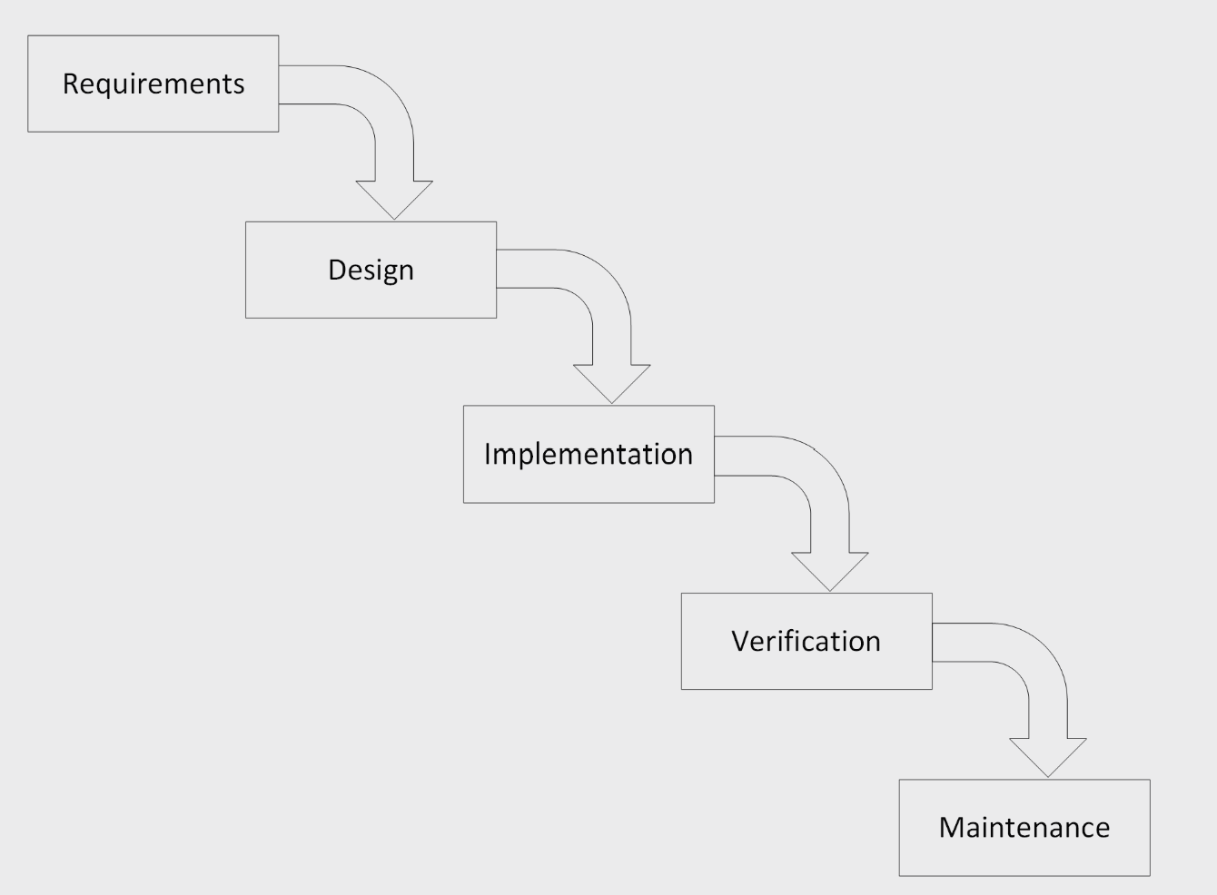
Waterfall Model
Typically consists of these five “common” steps
Projects flows linearly
“Predictive” methodology focusing on heavy upfront planning
Testing performed at end of development
Diagram: (Ingeno, 2018)

Slide 13
The detox/wellness requirement
Agile/Scrum
Waterfall
“Adaptive” to change enabled success
Communication with stakeholders throughout lifecycle
Reprioritized product backlog to adapt to change
Collaboration and self-organized teams focused on delivering new requirement
“Predictive” and inflexible to change
Communication with stakeholders only at front end
Must iterate again or restart cycle to respond to changes
Little collaboration during phases; documentation and process stifle change

Slide 14
Choose Agile or Waterfall
Agile/Scrum
Waterfall
Great when there is high degree of uncertainty in requirements
Best approach when high risk of change
Processes are purposely “loose” so that team can adapt
Desirable for scaling project size and adjusting product backlog per priorities
Great when requirements are well defined
Suitable when there is low risk for change
Well defined processes means project is easier to manage
Great for small projects

Slide 15
References
Agile Alliance. (2018, December 12). Agile Manifesto for Software Development. Agile Alliance; Agile Alliance. https://www.agilealliance.org/agile101/the-agile-manifesto/
Cobb, C. G. (2015). The project manager’s guide to mastering agile: Principles and practices for an adaptive approach. John Wiley.
Ingeno, J. (2018). Software Architect’s Handbook: Become a successful software architect by implementing effective architecture concepts. Packt Publishing Ltd.
ScrumGuides.org. (n.d.). Home | Scrum Guides. Scrumguides.org. https://scrumguides.org/

Slide 16
Photo References
Ena, C. (2007, July 10). Fabian Cancellara. Wikimedia Commons. https://commons.wikimedia.org/wiki/File:Stage_3_Fabian_Cancellara_is_the_early_hero_of_the_2007_Tour_de_France.jpg
Gabinho. (2017, April 14). Rugby Scrum 2017. Wikimedia.org. https://commons.wikimedia.org/wiki/File:CSA_Steaua_Bucure%C8%99ti_-_Timi%C8%99oara_Saracens_Rugby_Scrum_2017.jpg
Leask, R. (2010, June 29). Coade Stone Pillars. Commons.wikimedia.org. https://commons.wikimedia.org/w/index.php?search=Coade_Stone_Pillars_-_geograph.org.uk_-_1942778&title=Special:MediaSearch&go=Go&type=image
Creative Commons License:
Creative Commons — Attribution-ShareAlike 2.0 Generic — CC BY-SA 2.0. (n.d.). Creativecommons.org. https://creativecommons.org/licenses/by-sa/2.0/deed.en

